Slide 1
IMPLEMENTATION OF CONVOLUTIONAL NEURAL NETWORKS IN FPGA
Mark A. Espinosa
Spring 2019

Slide 2
Background Info
Current State of the art

Slide 3
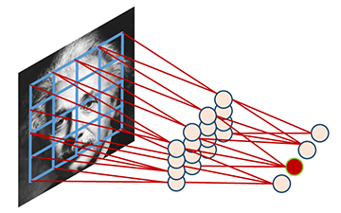
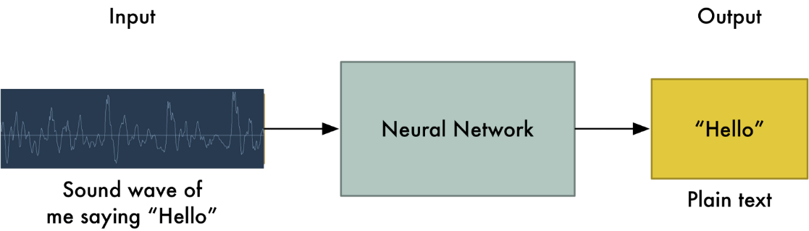
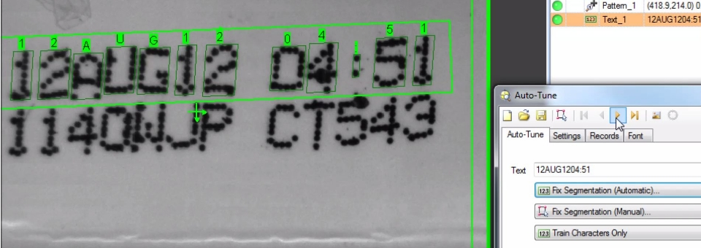
Machine Learning
Machine learning can be described as when a computer program is said to learn from experience E with respect to some task T and some performance measure P, if its performance on T, as measured by P, improves with experience E.
Learning algorithms have been successfully deployed in a variety of applications, including:
Speech recognition, speech synthesis, speaker verification
Optical character recognition (OCR)
Computer vision tasks

Slide 4
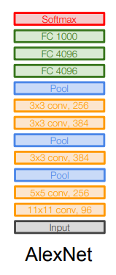
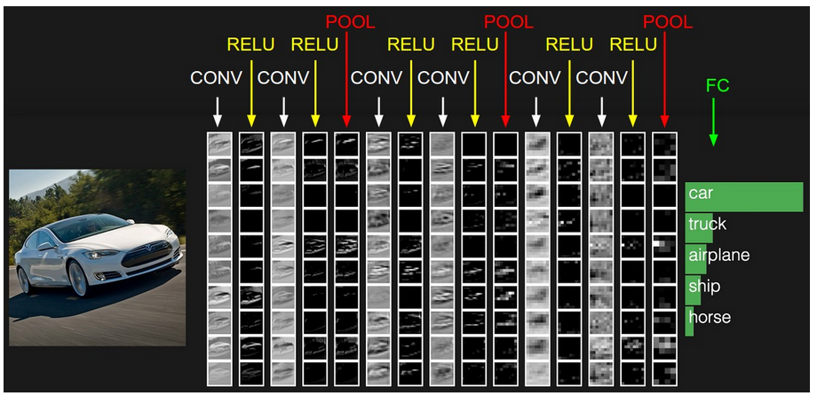
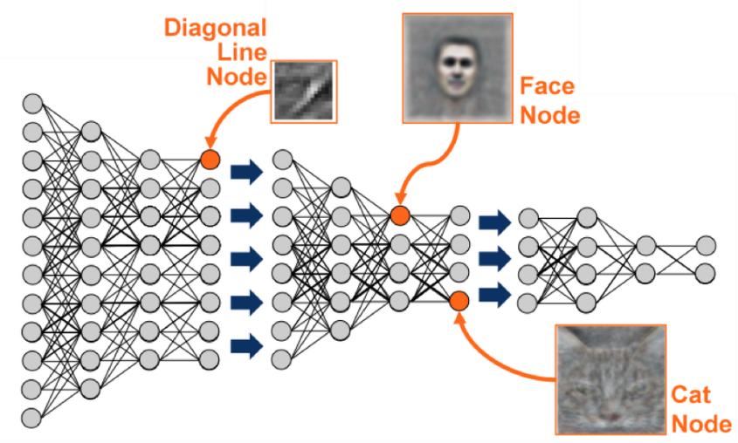
Deep Learning
Deep learning carries out the machine learning process using an artificial neural net that is composed of a number of levels arranged in a hierarchy. The network learns something simple at the initial level in the hierarchy and then sends this information to the next level. The next level takes this simple information, combines it into something that is a bit more complex, and passes it on the third level. This process continues as each level in the hierarchy builds something more complex from the input it received from the previous level.
We use four main types of layers to build ConvNet architectures:
Convolutional Layer
Rectified Linear Activation Layer
Pooling Layer
Fully-Connected Layer (exactly as seen in regular Neural Networks).

Slide 5
Thesis
Implementation of Deep Convolutional Neural Networks is normally done by Computer Scientists using GPUs on Desktop or Laptop Computers.
FPGA implementation of Deep Convolutional Neural Networks would allow for smaller embedded solutions to be designed which would consume less power than GPU solutions.
Allowing an FPGA implementation of Deep CNNs to be programmed by software and use known Deep Learning Architectures would allow for the faster system development .
This work efforts to design and develop a scalable, reusable, and user-friendly FPGA implementation of Convolutional Neural Networks for Image Classification tasks.
Allowing the This design would cater to the smaller more inexpensive Embedded Designs which have strict power and computation constraints.

Slide 6
Implementation Concept
Convolutional Neural Network Layers

Slide 7
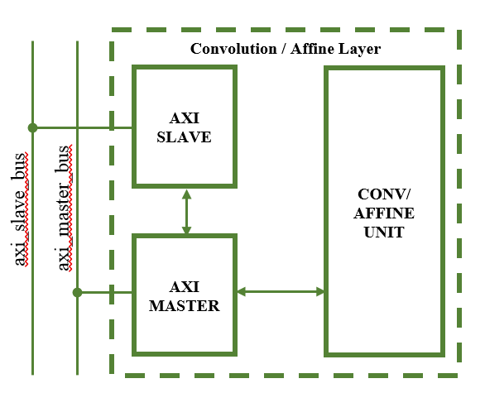
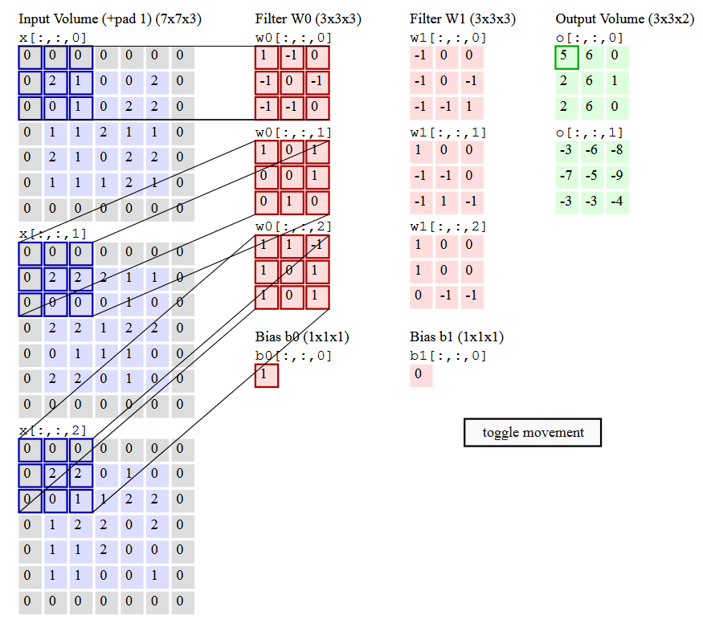
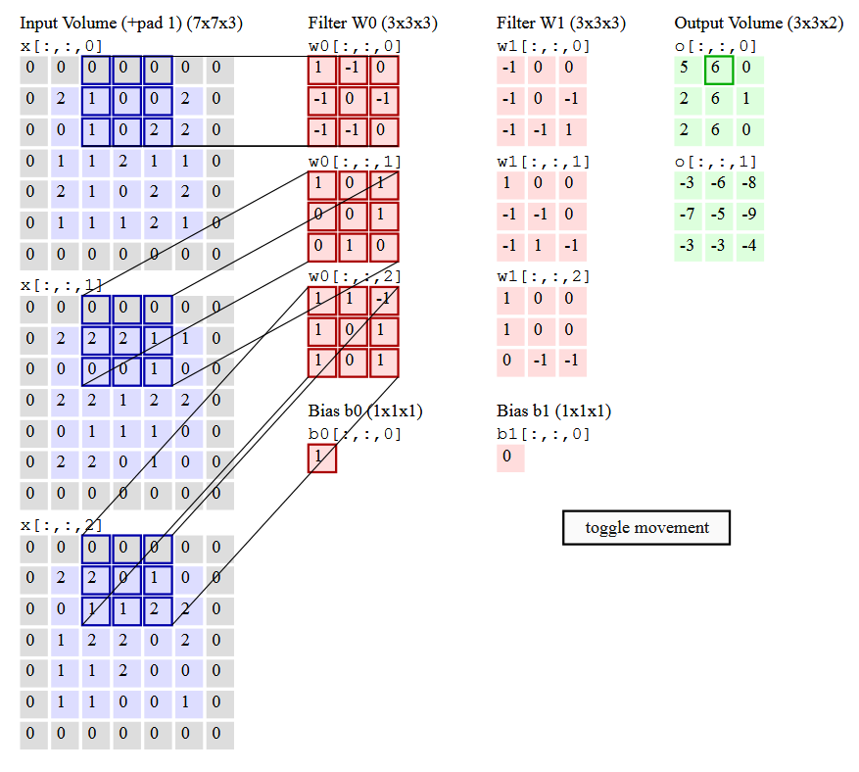
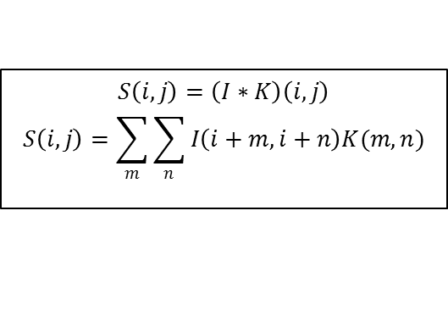
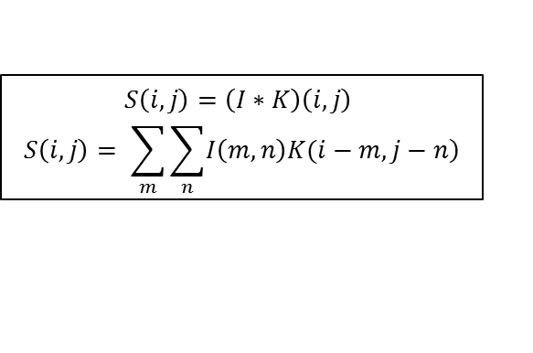
Convolution/Affine Layer
$$S\left(i,j\right)=\left(I∗K\right)\left(i,j\right)$$
$$S\left(i,j\right)= \sum_{m}{\sum_{n}{\left.I\left(m,n\right)K(i−m,j−n\right)}}$$
$$S\left(i,j\right)=\left(I∗K\right)\left(i,j\right)$$
$$S\left(i,j\right)=\sum_{m}{\sum_{n}{I\left(i+m,i+n\right)K(m,n)}}$$
The Convolution Operation involves applying a weight filter kernel to an input image in order to generate an output volume. These output volumes in effect filter the image for certain features which are determined during training of the weight set of the Neural Network.
So, for the case with a 3x3 filter weight kernel, 9 filter weight values are multiplied by 9 image data values, to generate 9 products. These 9 products are then summed together in order to produce the output volume.
This is done for each color of the input image and in subsequent volumes/filter maps, each channel. This operation is again repeated for each subsequent weight filter set. So, if a 227x227x3 image has an 11x11x3x96 weight filter kernel set applied to it, with a stride and pad of 2, the resulting output volume would be 55x55x96.

Slide 8
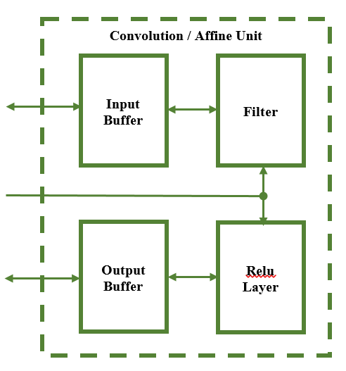
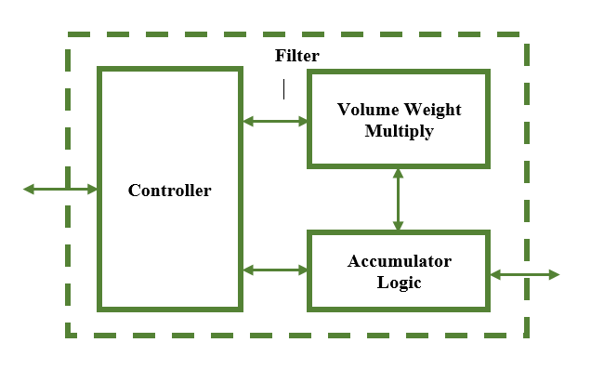
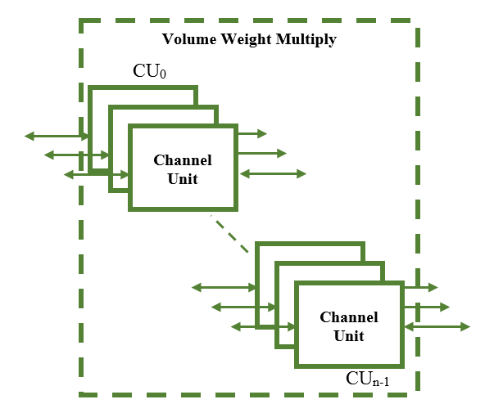
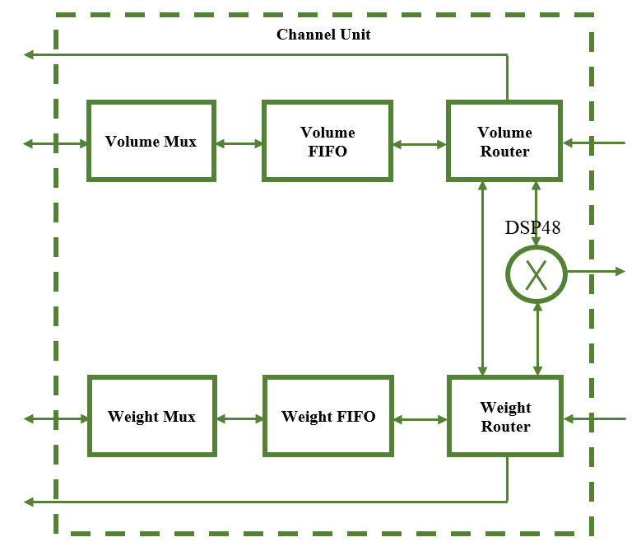
Convolution / Affine Layer
The heart of this design is the Channel Unit which involves the use of a FIFO buffer and glue logic to perform vital operations of the Convolution and Affine layer in the Convolutional Neural Network.
This design utilizes heavily the available DSP resources on the FGPA chip. The number of available DSPs dictates the maximum number of Channel Units instantiated into the design.
Operationally each Channel Unit corresponds to 1 row of data of the input image or 1 row of data for all the filters for the weight data set. Weight filter kernels in Convolutional Neural Networks typically have a size of 3x3, 5x5, 7x7, or 11x11. Therefore, the height of the weight filter kernel will dictate the number of input volume channels that can be operated on at any given time.

Slide 9
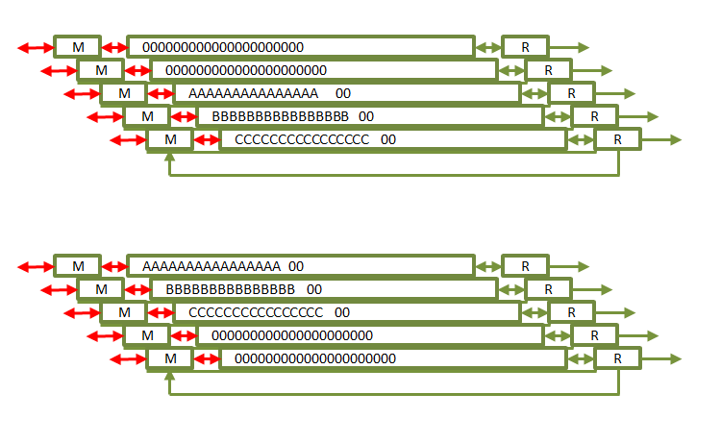
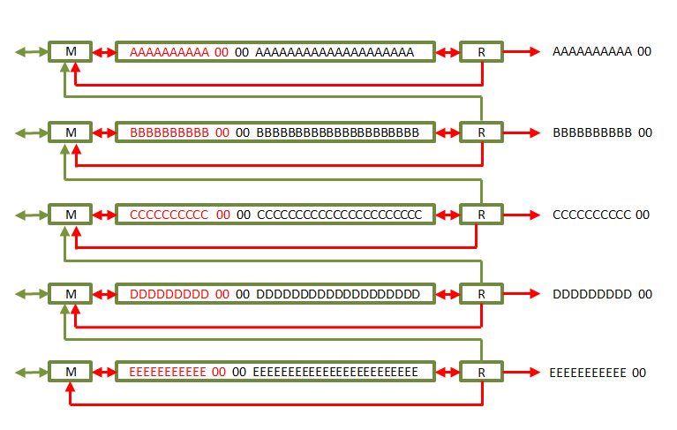
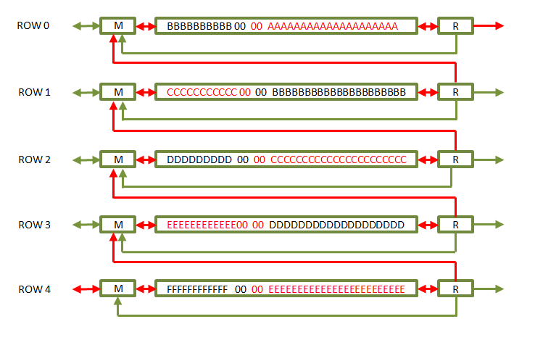
Convolution / Affine Layer
When the design is given a new input data volume to use in the execution of a Convolution or Affine operation it proceeds as shown above.
The Controller loads full rows of both input and weight data into the appropriate Channel Unit FIFO.
For Convolutional Layers the input data may be zero padded around the boarders of the input data volume. Therefore, the input data image will have top, bottom, right, and left boarders with zero value data.
After the rows have been loaded, the Routers for the Weight Data read out the first Weight Filter Kernel and hold it in registers. Once the kernel is ready, the Routers on the Volume FIFOs begin to read out the input volume data while also accounting for stride across the row itself.
As both input data and weight kernel are read out simultaneously, they are sent to the Channel Units DSP48 multiplier block. Also, simultaneously the input volume data is written back into the input data FIFOs.
After all the weight filter kernels have been used with the input data volume rows, the vertical stride operation begins so to satisfy the vertical stride required for the Convolution operation.
The Router for each Channel Unit reads out its FIFOs data and sends the data to the Mux of the Channel Unit neighboring it.
New data enters the Row 4 FIFO.
Current data in the Row 4 FIFO is redirected and written into the Row 3 FIFO. So On…

Slide 10
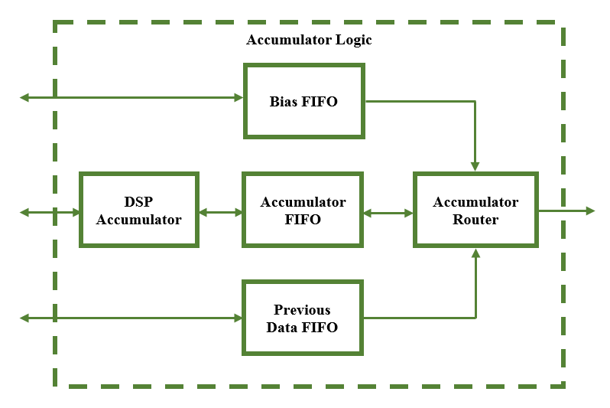
Convolution / Affine Layer
As the DSP48 Multipliers begin to output valid product data and their accompanying valid signals, the DSP Accumulator uses an adder tree to sum the results of the Convolution or Affine operation together.
The results of the adder tree are summed together to arrive at the Kernel Sum. This sum is written to the Accumulator FIFO.
The Accumulator Router reads the Accumulator FIFO data and uses a DSP48 Adder to perform a Floating-Point Single Precision Addition between the Accumulator FIFO data and the Bias data or the Previous data.
The design is only able to process a limited number of input volume channels at a time. This requires the design to process groups of channel s at a time creating an iterative processing scheme. Therefore, the first iteration will add the Bias Data and subsequent iterations will add the Previous Data together with the data from the Accumulator FIFO.

Slide 11
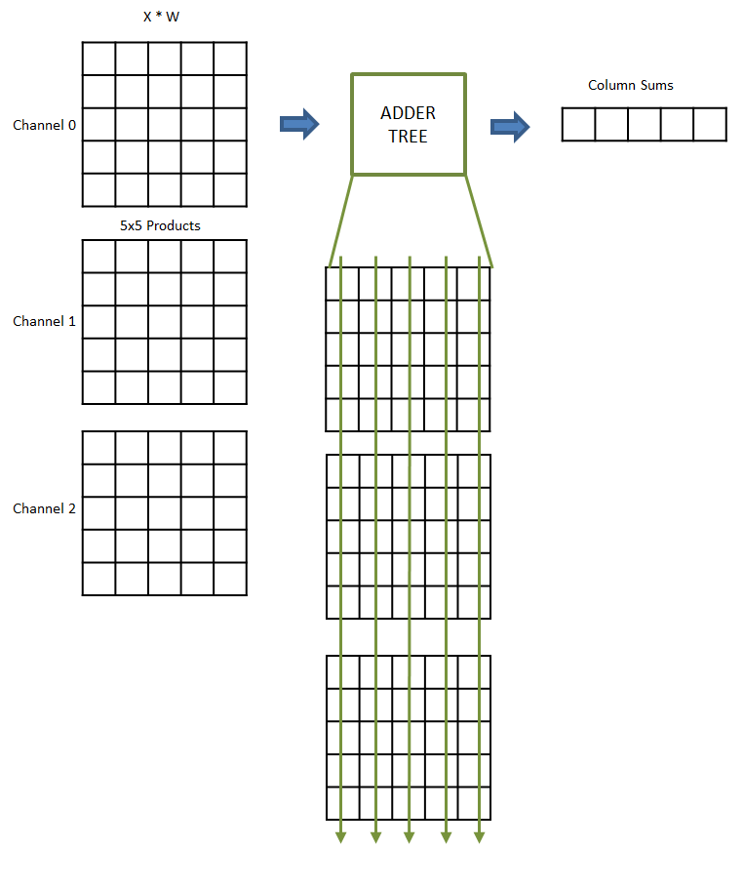
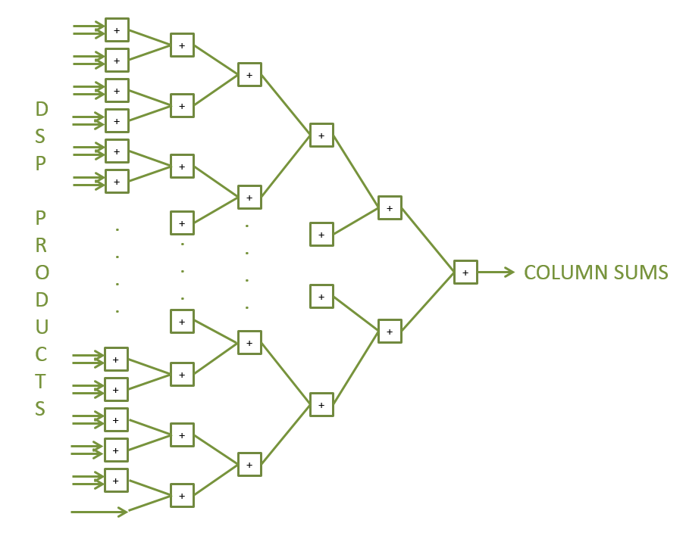
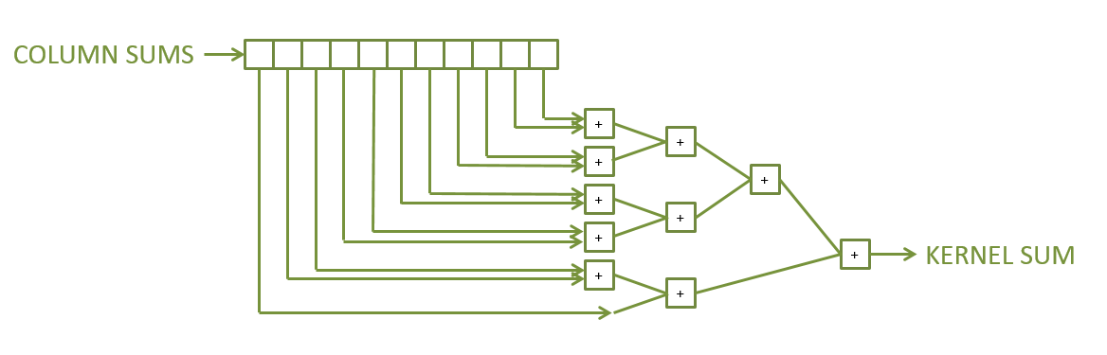
Convolution / Affine Layer
Since the upstream logic in the Channel Units moves across the Input Volume row by row, the product results received by the DSP Accumulator will be the size of the Weight Filter Kernel by as many channels being processed.
Therefore, the result of the adder tree will be the summation of the columns.
If we have input volume data X with 3 channels and Weight Filter Kernel W with a size 5x5, the result of the Adder Tree is 5 wide and is the summation of all the product data down the columns.
Once the column sum data is obtained, the column sums are again summed by a smaller adder tree to obtain the single Kernel Sum data value.
This process repeats as the Channel Units produce data for the rest of the filters in the Weight set.

Slide 12
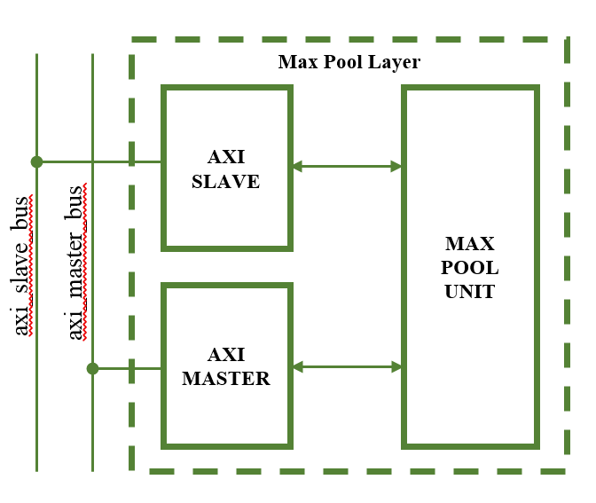
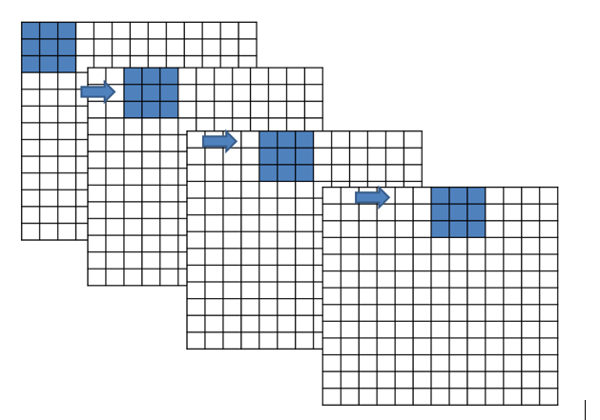
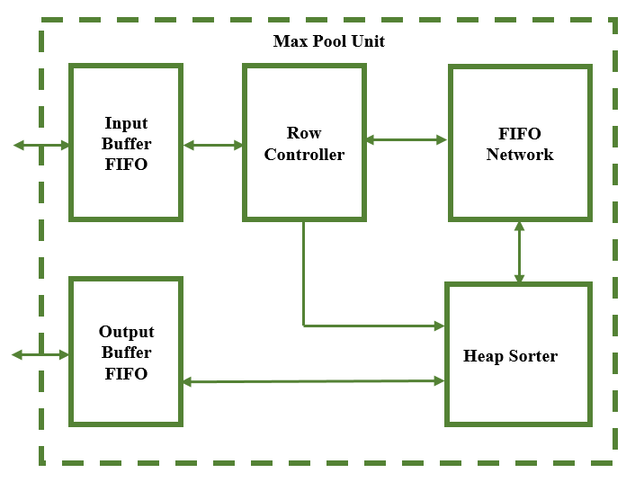
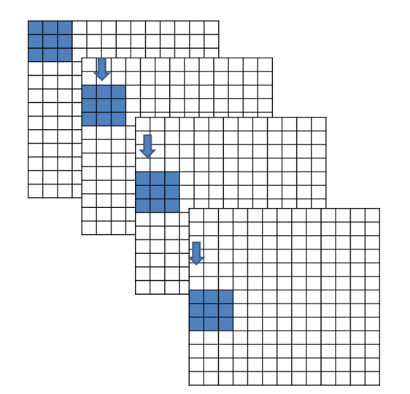
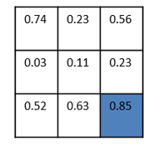
Max Pooling Layer
Let’s say we have an image of size 13x13x256, a filter kernel with size 3x3, and a stride of 2.
The Max Pooling operation involves sliding a 3x3 kernel across 3 rows by 3 columns at a time. The stride involves moving the kernel across the image in increments of 2 pixels in both vertical and horizontal directions.
At each increment the kernel considers all the values in the 3x3 neighborhood and chooses the greatest value.
This value is passed by the kernel to be the output pixel value for the scaled down Max Pooled image. This process is repeated across the height, width, and channels of the input image to generate a full Max Pooled image.
Given an input image of 13x13x356, the output is a Max Pooled image of size 6x6x256

Slide 13
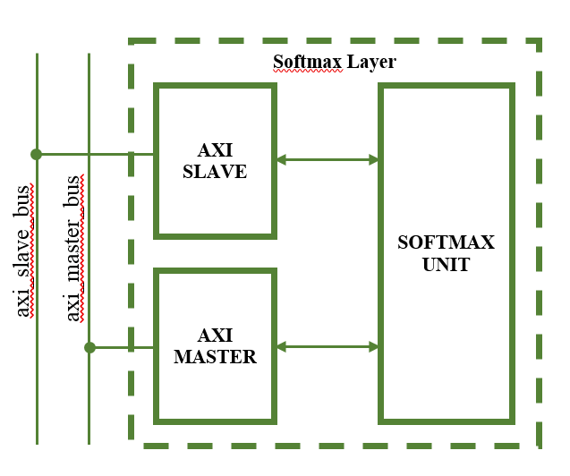
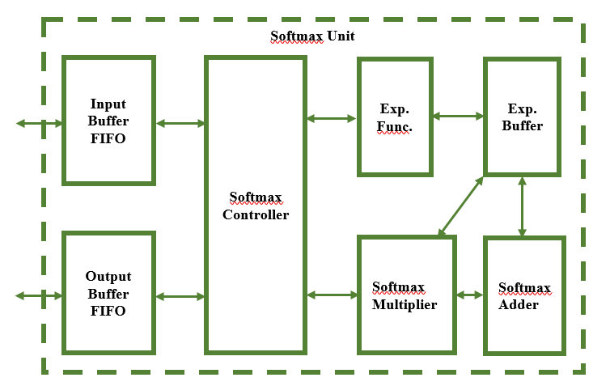
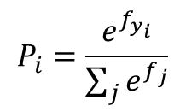
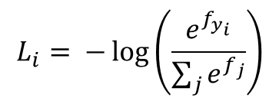
Softmax Layer
A Convolutional Neural network is configured to arrive at several class scores and thereby classify the image it is given.
These scores are then passed through a loss or cost function and used to arrive at a loss or cost value. This is to measure how well the neural network has classified the image it was given. Therefore, the loss will be high if we are doing a poor job of classifying the image and low if we are doing well.
A popular classifier, which will compute the loss, is the Softmax Classifier. The Softmax classifier outputs the normalized class probabilities.
Due to mathematical complexity in the FPGA implementation, the Probabilities are output by the Softmax Layer.
$$L_{i}= −\log\left(\frac{e^{f_{y_{i}}}}{\sum_{j}{e^{f_{j}}}}\right)$$
$$P_{i}=\frac{e^{f_{y_{i}}}}{\sum_{j}{e^{f_{j}}}}$$

Slide 14

Trained Model
For this project there existed absolutely no tools prior to commencing this work nor were there peers available which had prior experience. Therefore, a considerable amount of time was invested into developing an array of tools in various software environments that would be capable of testing the design to completion.
To develop a trained model of a Convolutional Neural Network, tools from Stanford University’s CS231N were used in conjunction with a very small training set.
Using the Stanford tools, a small data set of 10 images was used to train an AlexNet Convolutional Neural Network. These images were selected randomly from a list of 10 Classes.
Images were selected from the ImageNet database.
The ImageNet database contains roughly 100,000 individual images spanning 1000 or more classes with each image differing in size.
Therefore additional tools Python tools were created to search the database for specific files, determine their size, obtain their bounding box boundaries, and finally resize the image to the 227x227 AlexNet input image size.
Class Number | ImageNet ID | Class Description
1 | n04548362 | wallet, billfold, notecase, pocketbook
2 | n03642806 | laptop, laptop computer
3 | n03063599 | coffee mug
4 | n02690373 | airliner
5 | n03930630 | pickup, pickup truck
6 | n01614925 | bald eagle, American eagle, Haliaeetus leucocephalus
7 | n03085013 | computer keyboard, keypad
8 | n02708093 | analog clock
9 | n03272010 | electric guitar
10 | n02992529 | cellular telephone, cellular phone, cellphone, cell, mobile phone

Slide 15
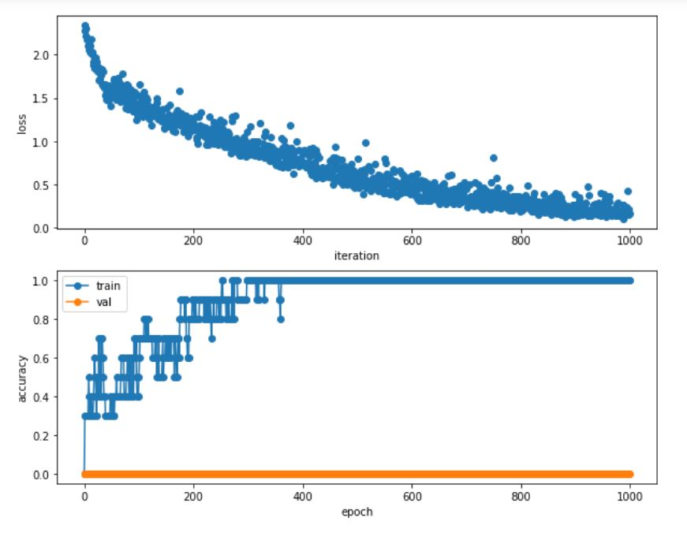
Trained Model
Regularization = 0.0 (No Regularization)
Learning Rate = 5x10⁻³
Weight Scale = 1.5x10⁻²
Iterations = 1000
Batch Size = 10
Update Rule = Stochastic Gradient Descent
Learning Rate Decay = 1.0 (No Decay)

Slide 16
Results
Performance and Output

Slide 17
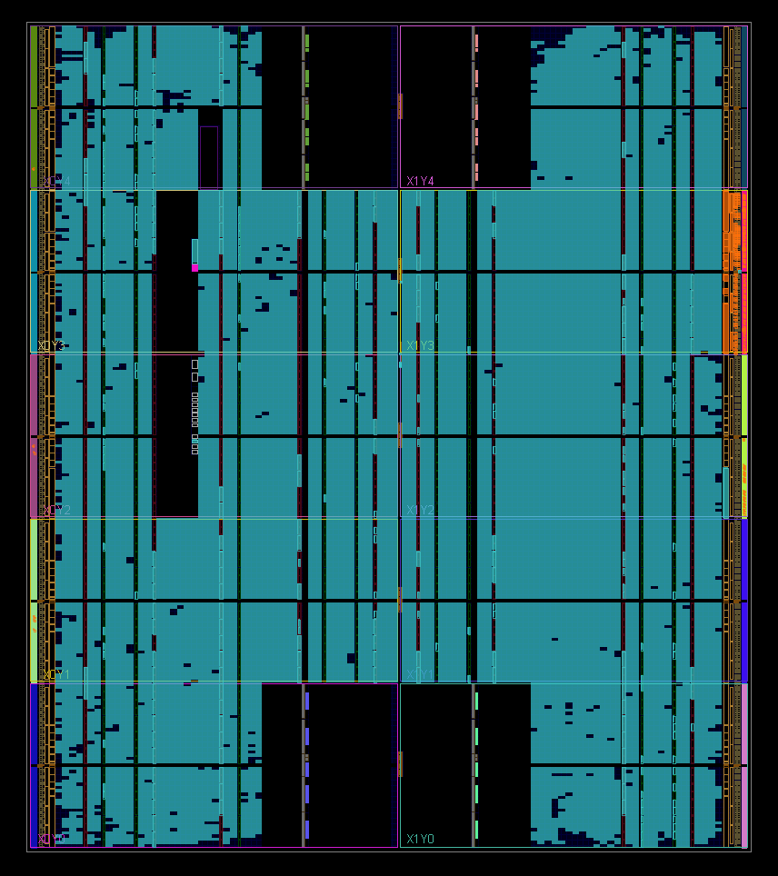
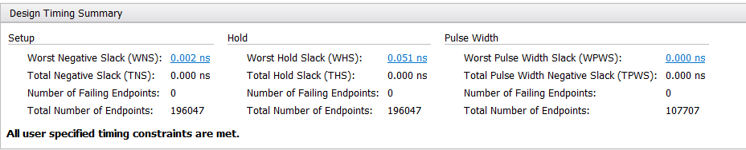
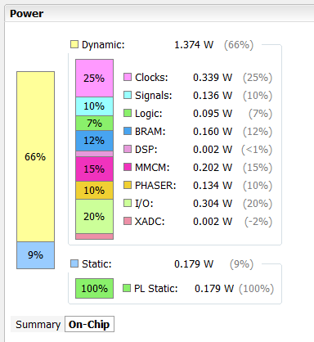
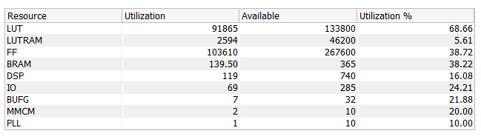
Synthesized & Implemented Design
The implementation of a Convolutional Neural Network on FPGA met its timing requirements with the constraint of a 100MHz input clock frequency.
The design currently is using ~70% of the FPGA Look-up Tables, ~40% of the FPGA Flip Flops, and ~40% of the FPGA Block RAM. It is worth making special mention that the design currently only uses ~16% of the FPGA DSPs.

Slide 18
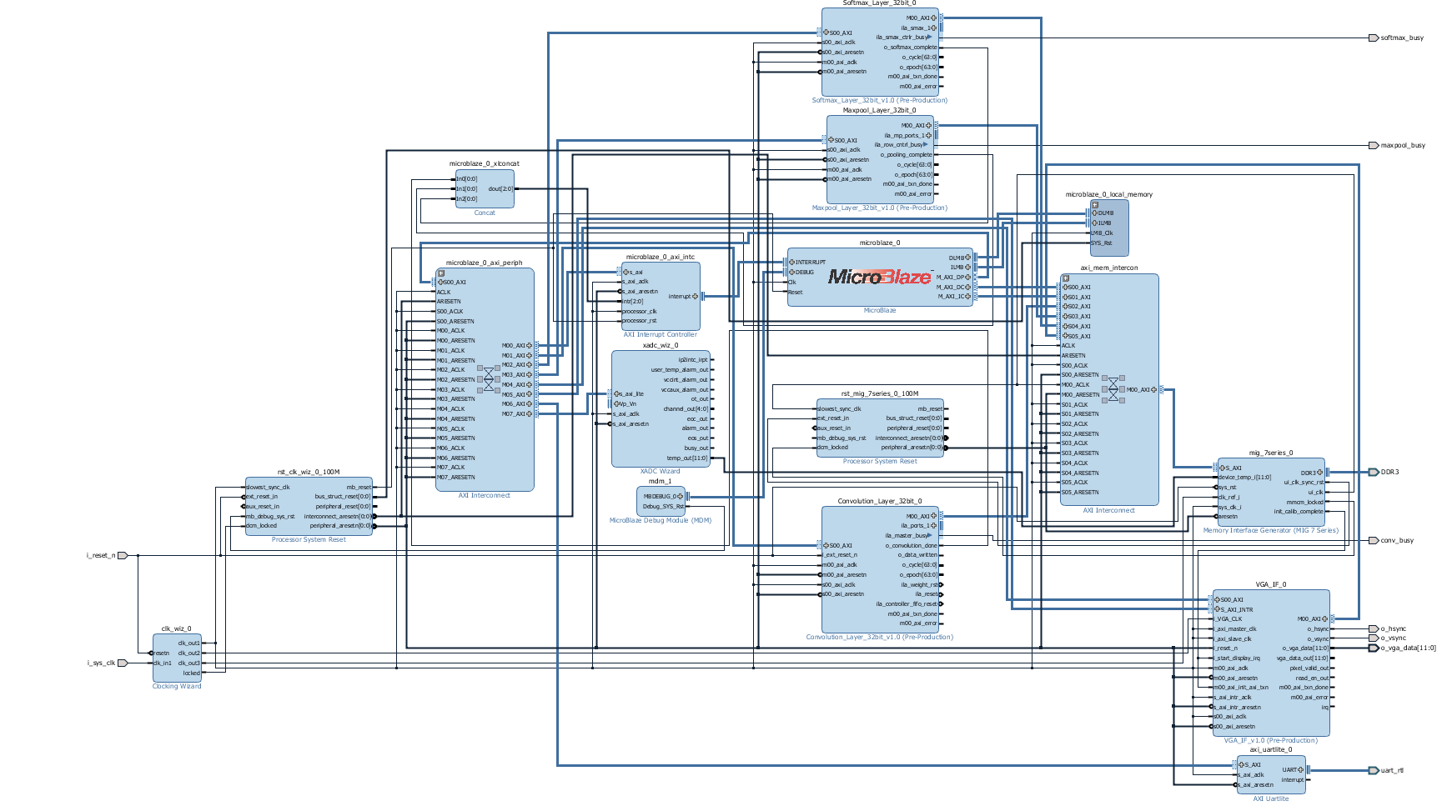

Slide 19
Floating-Point Operations (FLOP)
We know that each Convolution and Affine layer will perform a certain number of Floating-Point Operations.
We can say that the total number of Floating-Point Operations divided by the time of execution yields the Floating-Point Operations per Second.
The calculations arriving at the total number of Floating-Point Operations are detailed in the report and are summarized below.
 | CHU_FLOP | ACC_FLOP | BIAS_FLOP | ROW_FLOP | VOL_FLOP
CONV1 | 1916640 | 1906080 | 96 | 3822720 | 210249696
CONV2 | 1036800 | 1168128 | 256 | 2204928 | 62332672
CONV3 | 359424 | 524160 | 384 | 883584 | 13498752
CONV4 | 359424 | 524160 | 384 | 883584 | 14537088
CONV5 | 239616 | 349440 | 256 | 589056 | 9691392
AFFINE1 | 589824 | 823296 | 4096 | 1413120 | 90701824
AFFINE2 | 131072 | 167936 | 4096 | 299008 | 38797312
AFFINE3 | 320 | 410 | 10 | 730 | 94720

Slide 20
Memory Transactions
We know that each Convolution and Affine layer will perform a certain number of Floating-Point Operations.
We can say that the total number of Floating-Point Operations divided by the time of execution yields the Floating-Point Operations per Second.
The calculations arriving at the total number of Floating-Point Operations are detailed in the report and are summarized below.
Layer | Input Read Trans. | Weight Read Trans. | Bias Read Trans. | Prev Read Trans. | Write Trans. | Total Mem Trans.
CONV1 | 651 | 96 | 1 | 0 | 5280 | 6028
CONV2 | 2592 | 256 | 1 | 103680 | 110592 | 217121
CONV3 | 3328 | 384 | 1 | 154752 | 159744 | 318209
CONV4 | 4992 | 384 | 1 | 234624 | 239616 | 479617
CONV5 | 4992 | 256 | 1 | 156416 | 159744 | 321409
AFFINE1 | 256 | 262144 | 1 | 258048 | 262144 | 782593
AFFINE2 | 4096 | 524288 | 1 | 520192 | 524288 | 1572865
AFFINE3 | 4096 | 1280 | 1 | 1270 | 1280 | 7927

Slide 21
Sim and Hardware Performance
Layer | Start Time | End Time | Total Time | FLOPs
CONV1 | 2.725us | 71733.655 us | 71.73093 ms | 2.931 G
CONV2 | 2.725us | 485199.955 us | 485.19723 ms | 128.468 M
CONV3 | 2.725us | 363293.625 us | 363.2909 ms | 37.156 M
CONV4 | 2.725us | 545573.945 us | 545.57122 ms | 26.645 M
CONV5 | 2.725us | 364695.804598us | 364.693079598ms | 26.574 M
AFFINE1 | 2.725us | 514410.525 us | 514407.8 ms | 176.322 M
AFFINE2 | 2.725us | 442502.215 us | 442499.49 ms | 87.677 M
AFFINE3 | 2.725us | 27927.805 us | 27925.08 ms | 33.919 M
Layer | Start Time | End Time | Total Time | FLOPs
CONV1 | 0 | 71198.67 us Epoch = 0x1161e Cycle = 0x43 | 71.19867 ms | 2.9530 G
CONV2 | 0 | 547753.71 us Epoch = 0x85BA9 Cycle = 0x47 | 547.75371 ms | 108.806 M
CONV3 | 0 | 463776.90 us Epoch = 0x713A0 Cycle = 0x5A | 463.77690 ms | 24.858 M
CONV4 | 0 | 697862.14 us Epoch = 0xaa606 Cycle = 0x0E | 697.86214 ms | 16.551 M
CONV5 | 0 | 466757.25 us Epoch = 0x71f45 Cycle = 0x19 | 466.75725 ms | 16.543 M
AFFINE1 | 0 | 796440.32 us Epoch = 0xc2718 Cycle = 0x20 | 796.44032 ms | 110.922 M
AFFINE2 | 0 | 1018890.52 us Epoch = 0xf8c0a Cycle = 0x34 | 1018.89052 ms | 33.446 M
AFFINE3 | 0 | 4682.26 us Epoch = 0x124A Cycle = 0x1A | 4.68226 ms | 17.769 M

Slide 22
Output Results
The ten randomly selected images from the 10 class list were run through the hardware FPGA implementation of a Convolutional Neural Network in the AlexNet configuration.
All 10 images were classified correctly by the FPGA hardware with the image’s class being correctly identified as being the one with the largest score out of 10 classes.
Image # | Image ID | Model Class | Model Score | HW Class | HW Score Hex | HW Score Dec | %Diff
1 | n02690373_3435 | 4 | 7.771 | 4 | 0x40F8778B | 7.7646 | 0.0824
2 | n02708093_1783 | 8 | 5.008 | 8 | 0x40A05553 | 5.0104 | 0.0479
3 | n02992529_59933 | 10 | 4.844 | 10 | 0x409AF820 | 4.8428 | 0.0248
4 | n02690373_6755 | 4 | 9.227 | 4 | 0x41138E41 | 9.2222 | 0.0520
5 | n03930630_24834 | 5 | 6.361 | 5 | 0x40CB98F0 | 6.3624 | 0.0220
6 | n02708093_3688 | 8 | 5.808 | 8 | 0x40BA17C8 | 5.8154 | 0.1272
7 | n02690373_17389 | 4 | 9.753 | 4 | 0x411C0F50 | 9.7537 | 0.0072
8 | n03063599_3650 | 3 | 8.181 | 3 | 0x41028B29 | 8.159 | 0.2696
9 | n03063599_4149 | 3 | 5.665 | 3 | 0x40B4E50D | 5.653 | 0.2123
10 | n03063599_5006 | 3 | 7.136 | 3 | 0x40E41692 | 7.1278 | 0.1150

Slide 23
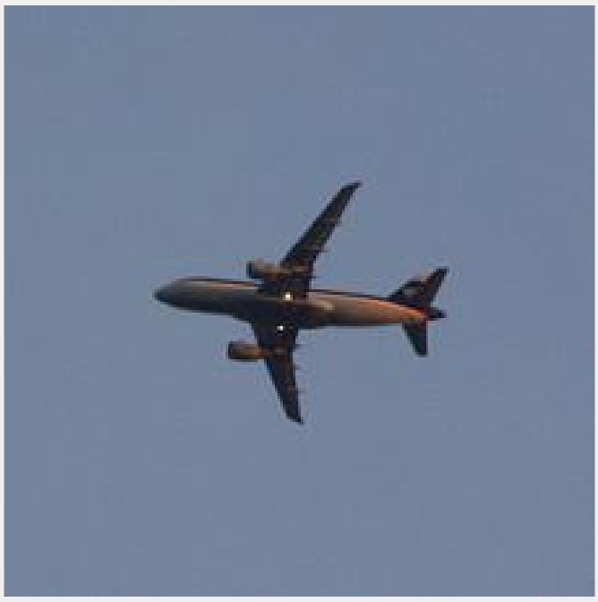
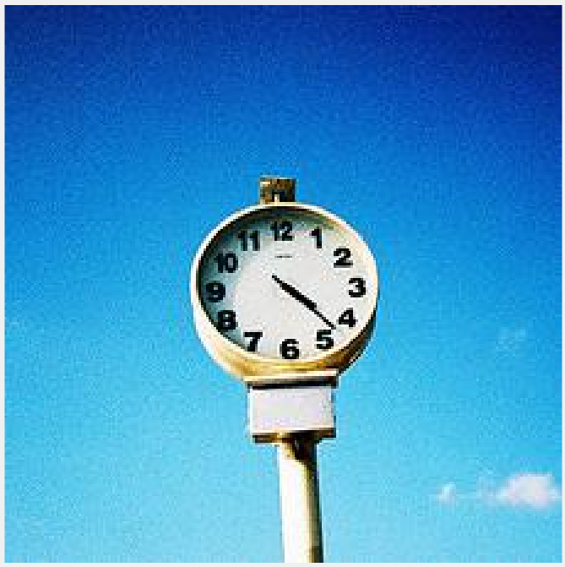
Output Results
n02690373_6755
n02708093_3688

Slide 24
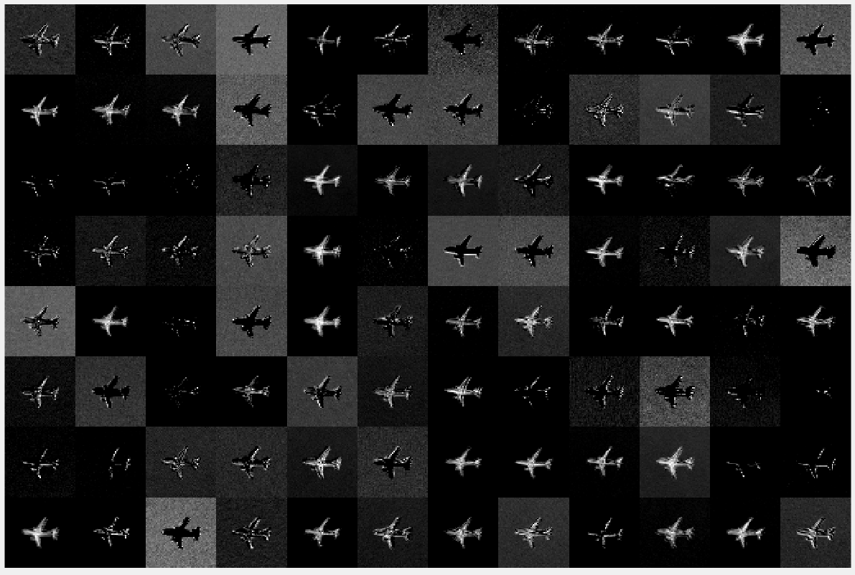
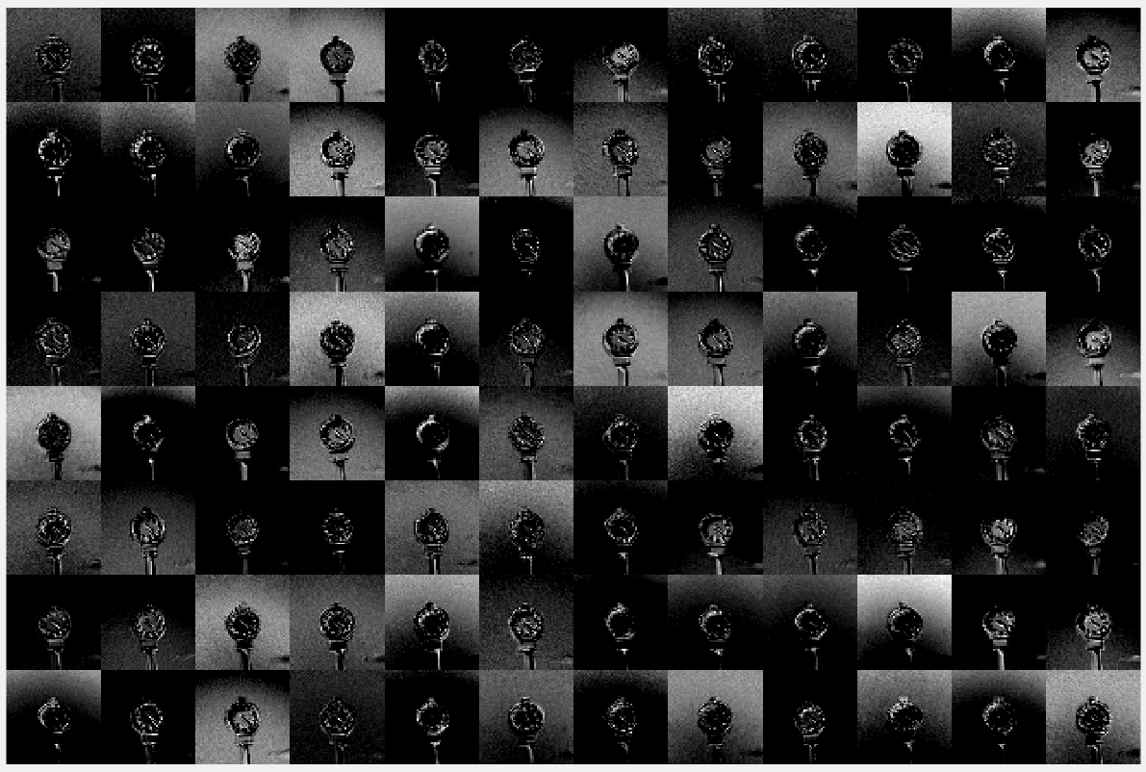
Output Results
CONV1 Output
55x55x96

Slide 25
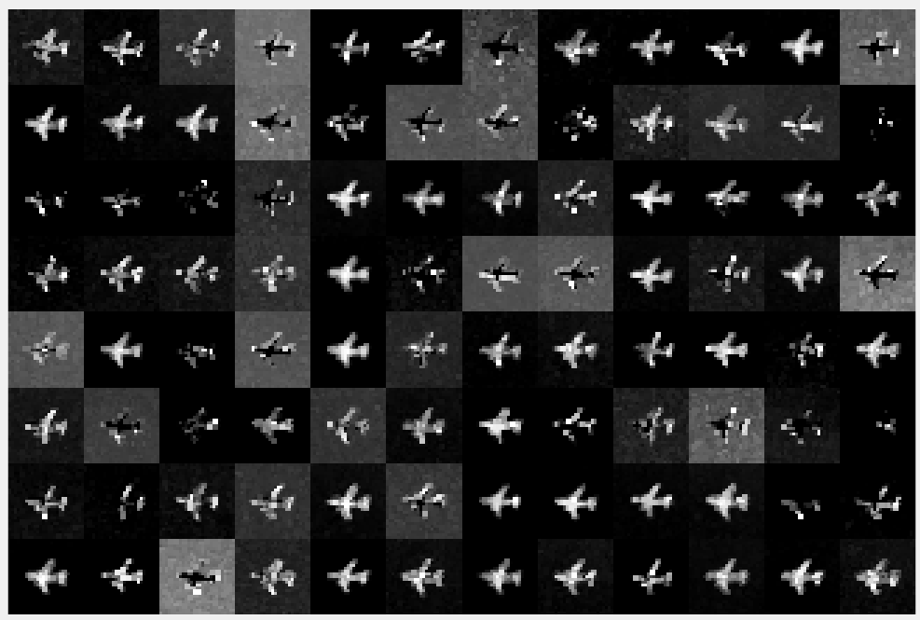
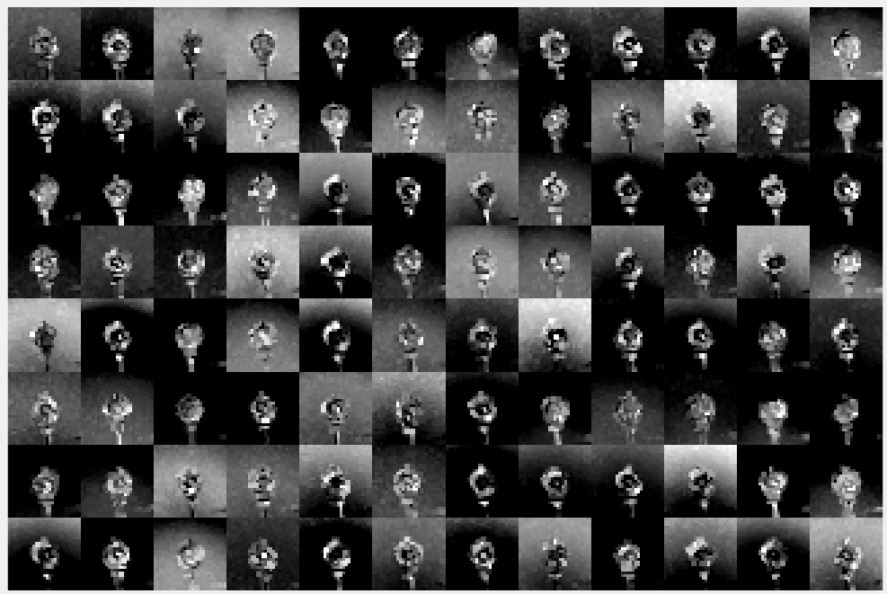
Output Results
MAXPOOL1 Output
27x27x96

Slide 26
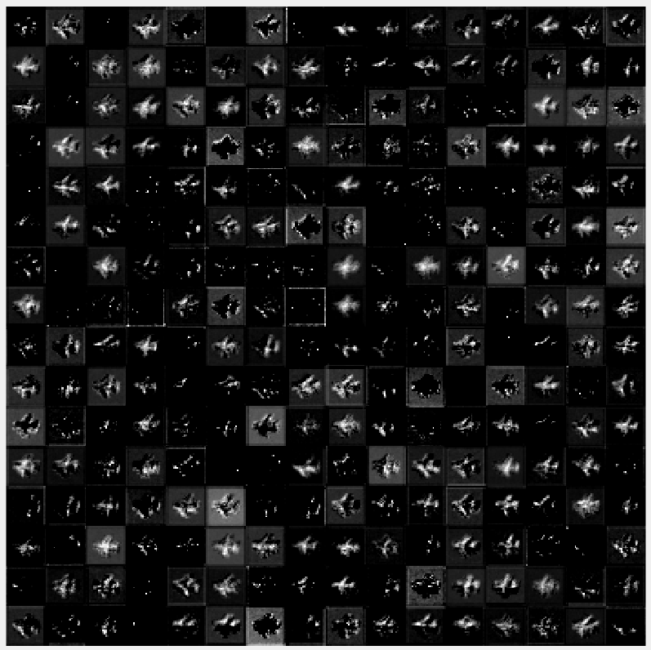
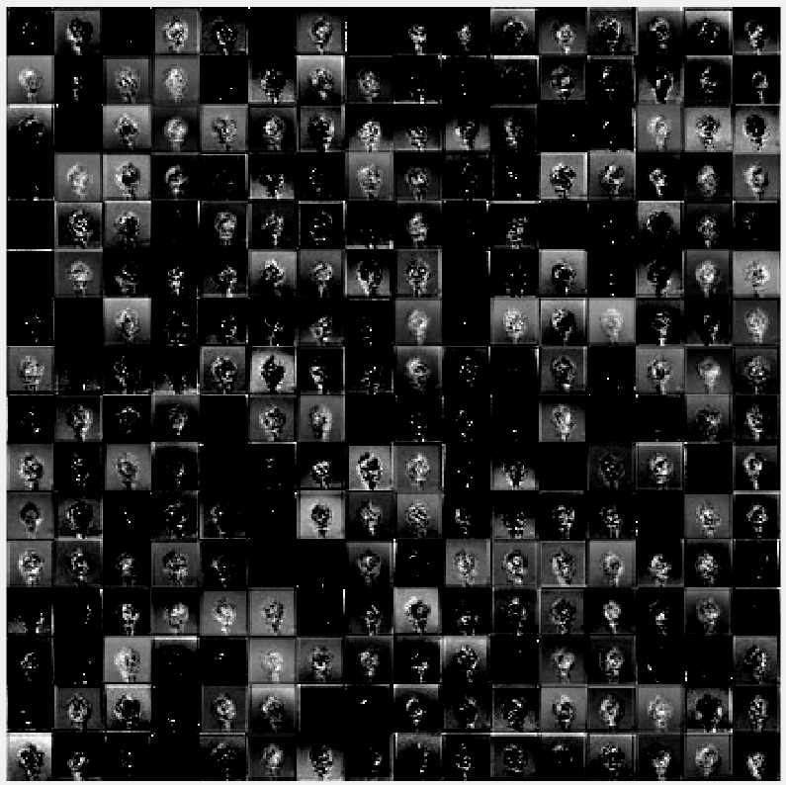
Output Results
CONV2 Output
27x27x256

Slide 27
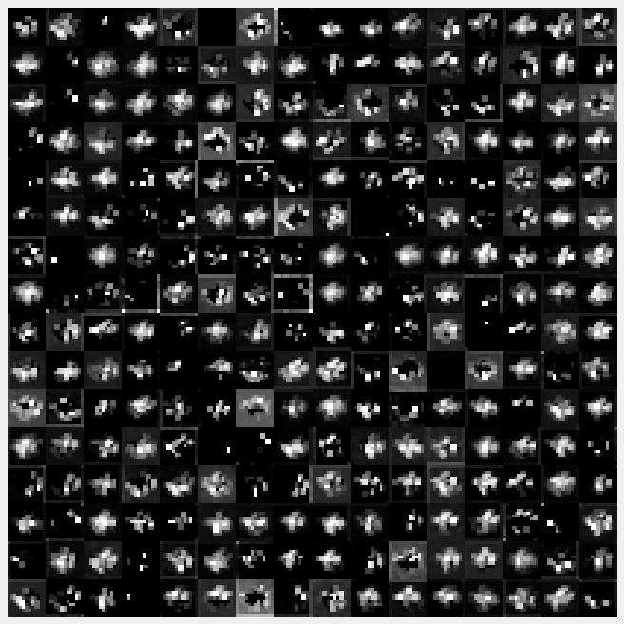
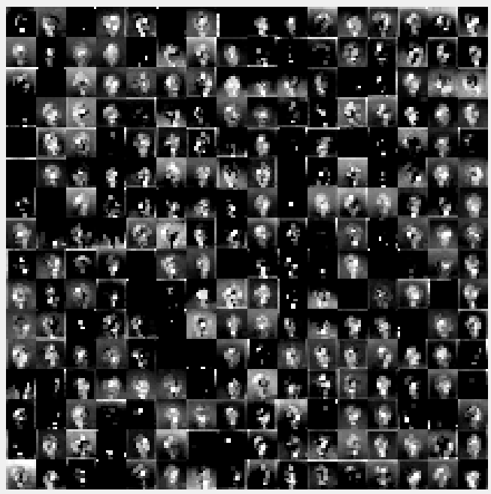
Output Results
MAXPOOL2 Output
13x13x256

Slide 28
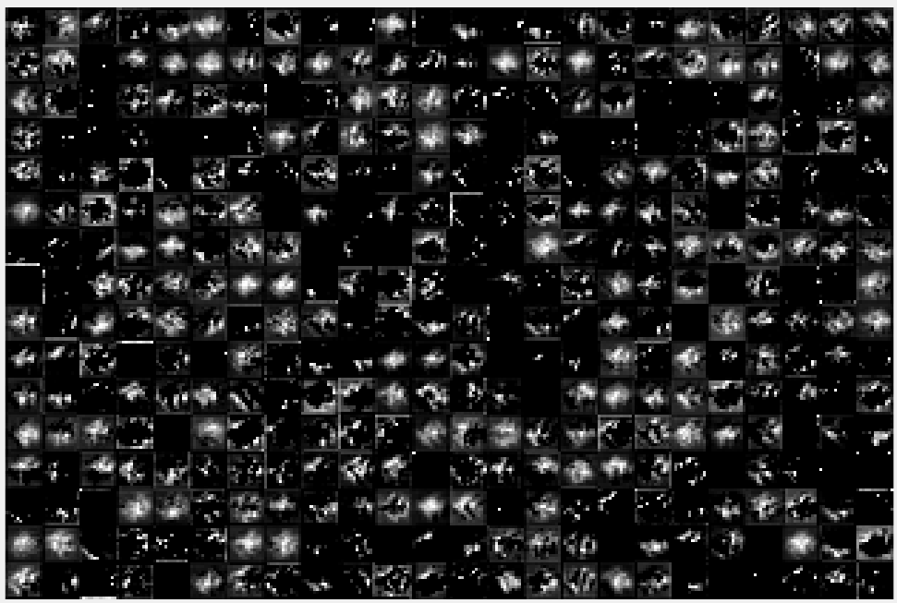
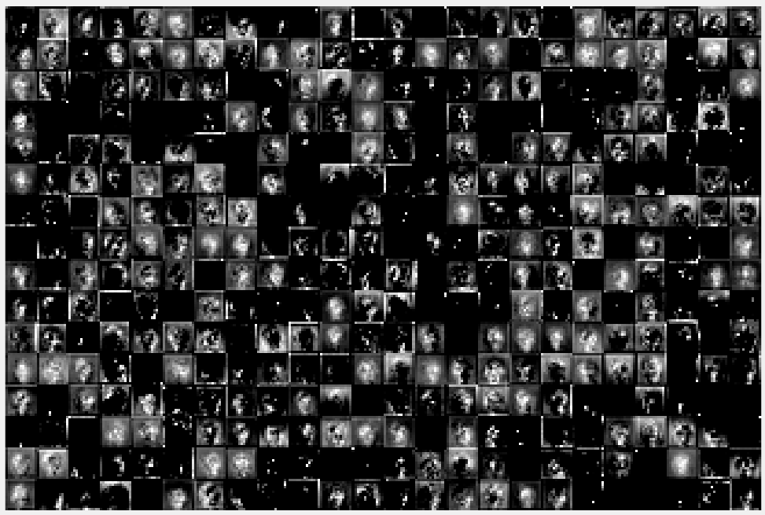
Output Results
CONV3 Output
13x13x384

Slide 29
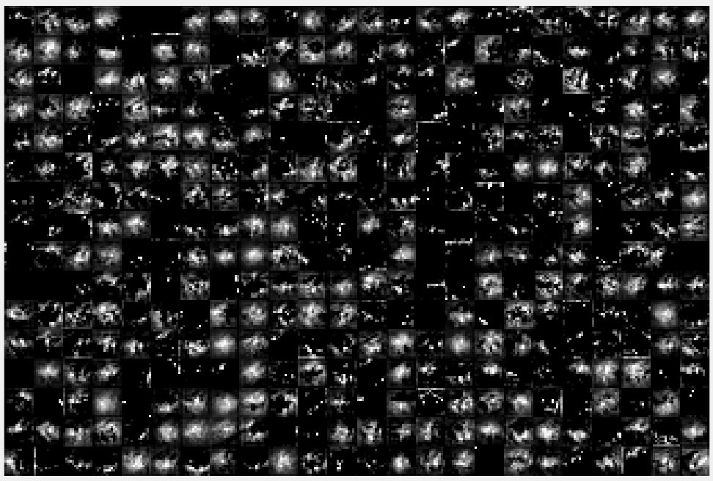

Output Results
CONV4 Output
13x13x384

Slide 30


Output Results
CONV5 Output
13x13x256

Slide 31


Output Results
MAXPOOL3 Output
6x6x256

Slide 32


Performance Breakdown
The relationship between the Floating Point Operations to be performed and the Memory Transactions needed can be seen when comparing the ratio between these two aspects and the measured Floating Point Operations Per Second achieved in the design. Despite having the greatest number of operations to perform, the first Convolution Layer was not slowed down by having to perform too many memory transactions. Therefore, this balance between the operations needed and the memory transactions needed dictated the achievable performance.
These derived relationships from observations about this design exactly coincide with the reasoning of CNN system behavior from a joint research collaboration between UCLA and Peking University in China.
Layer | Ops To Perform | SIM FLOPS | HW FLOPS | Total Mem Trans. | Ratio
CONV1 | 210249696 | 2.931 G | 2.9530 G | 6028 | 34878.85
CONV2 | 62332672 | 128.468 M | 113.796 M | 217121 | 287.09
CONV3 | 13498752 | 37.156 M | 29.106 M | 318209 | 42.42
CONV4 | 14537088 | 26.645 M | 20.830 M | 479617 | 30.31
CONV5 | 9691392 | 26.574 M | 20.763 M | 321409 | 30.15
AFFINE1 | 90701824 | 176.322 M | 113.884 M | 782593 | 115.90
AFFINE2 | 38797312 | 87.677 M | 38.077 M | 1572865 | 24.67
AFFINE3 | 94720 | 33.919 M | 20.229 M | 7927 | 11.95
$$Attainable Perf. =min\left\{\begin{aligned}&Computational Roof \\ &CTC Ratio ×BW\end{aligned}\right.$$

Slide 33
Hardware Breakdown

Slide 34
Simulation Breakdown

Slide 35
Performance Comparison
 | Guo, K. et. al., 2016 | Ma, Y et. al., 2016 | Zhang, C. et. al., 2015 | Qiao, Y. et. al., 2016 | This Work
FPGA | Zynq XC7Z045 | Stratix-V GXA7 FPGA | Virtex7 VX485T | Zynq XC7Z045 x 2 | Artix7 XC7A200T
Clock Freq | 150 MHz | 100MHz | 100MHz | 150MHz | 100MHz
Data format | 16-bit fixed | Fixed(8-16b) | 32-bit Float | 32-bit Float | 32-bit Float
Power | 9.63 W (measured) | 19.5 W (measured) | 18.61 W (measured) | 14.4 W (measured) | 1.5 W (estimated)
FF | 127653 | ? | 205704 | 218296 | 103610
LUT | 182616 | 121000 | 186251 | 183190 | 91865
BRAM | 486 | 1552 | 1024 | 402 | 139.50
DSP | 780 | 256 | 2240 | 836 | 119
Performance | 187.80 GFLOPS | 114.5 GFLOPS | 61.62 GFLOPS | 77.8 GFLOPS | 2.93 GFLOPS

Slide 36
Methods of Improvement
This implementation of a Convolutional Neural Network in an AlexNet configuration is a first pass attempt and leaves a lot room for improvement and optimization. There are a few ways the performance of this implementation can be increased which would be areas for future work.
Increase DSP Usage
The current design depends heavily on the Channel Unit structure to perform the Convolution and Fully Connected operations. Increasing the number of DSPs would allow for more channels to be processed at a given time. More channels per Convolution/Affine operation mean the required number of memory transactions decreases and this would increase the performance capability of each layer in the neural network.
Increase Clock Frequency
Another possible way of improving the achievable performance is to increase the clock frequency output by the Phase Locked Loop generating the FPGA system clock. The current design uses a 100MHz system clock frequency. Just doubling the clock frequency could possibly increase the max achievable system performance to 6 GFLOPs.
16bit Data Format
A method employed by some other works is to reduce the number of bits used to represent data values throughout the FPGA implementation of the Convolutional Neural Network. As discussed earlier, two other smaller data formats can be used instead of the one used in this work; 16-bit fixed and Half Precision.
Design Optimization
Another possible way of improving performance would be to optimize the already existing logic. As was stated earlier, this implementation is a first pass attempt and logic optimization for speed was sacrificed for functionality.

Slide 37
Conclusions

Slide 38
Conclusions
Machine Learning and Deep Learning its sub discipline are gaining popularity quickly and Machine Learning algorithms have been successfully deployed in a variety of applications such as Natural Language Processing, Optical Character Recognition, and Speech Recognition.
Convolutional Neural Network research has been firmly in the realm of Computer Science with much of the computation performed on large Graphical Processing Unit cards in desktop computer towers.
However, as it was seen in the literature, GPUs while effective at processing large amounts of image data, are extremely power hungry.
Therefore, this work set out to develop a scalable and modular FPGA implementation for Convolutional Neural Networks. It was the objective of this work to attempt to develop a system which could be configured to run as many layers as desired and test it using a currently defined CNN configuration, AlexNet. This type of system would allow a developer to scale a design to fit any size of FPGA from the most inexpensive to the costliest cutting-edge chip on the market.
Overall, the thesis of this work was proven to be correct that a system such as this can be developed for a small Embedded System and be easily programmed by software. The objective of this work was achieved, and all layers were accelerated including Convolution, Affine, ReLu, Maxpooling, and Softmax layers.

